Slide 1

Migraine Dataset
Monali Vijay Khot (U01007238)
Rapolu Ujwala (U01090412)
Sumanth Jampani (U01094559)

Slide 2
Content
Introduction
Assumption
Exploratory data analysis
Algorithms
Challenges
Conclusion
Future Work

Slide 3
Introduction
Migraine is a neurological condition characterized by recurrent headaches that can be severe and accompanied by various symptoms, such as nausea, vomiting, and sensitivity to light and sound. Researchers and data scientists often work with migraine datasets to gain insights into the condition, develop diagnostic tools, or improve treatment strategies.
Problem Statement / Motivation / List Survey:
Predicting headache types based on symptoms and characteristics. In our machine learning project, we used Logistic Regression, Decision Tree, KNN ,Random forest , and naive bayes algorithms to predict headache types based on symptoms. Motivated by improving early diagnosis, we found that different triggers and symptoms characterize migraines, tension-type headaches, and cluster headaches.
Objective: Develop a predictive model to classify types of migraines accurately.

Slide 4
Assumptions
In our data analysis project, we made some key assumptions to ensure our results are reliable.
we wanted to make sure that our features (the things we were studying) weren't connected or dependent on each other. We called this independence.
we checked if our data followed a normal, bell-shaped pattern because some of our tests rely on this.
we assumed a straight-line relationship between our predictors and what we were trying to find. This means changes in one thing would cause proportional changes in another.
we made sure that the errors in our predictions had a consistent level of variation, and we also checked that our predictors weren't too buddy-buddy with each other to avoid confusion.
These assumptions were like the rules of the road for our project, helping us navigate and trust the results we found.

Slide 5
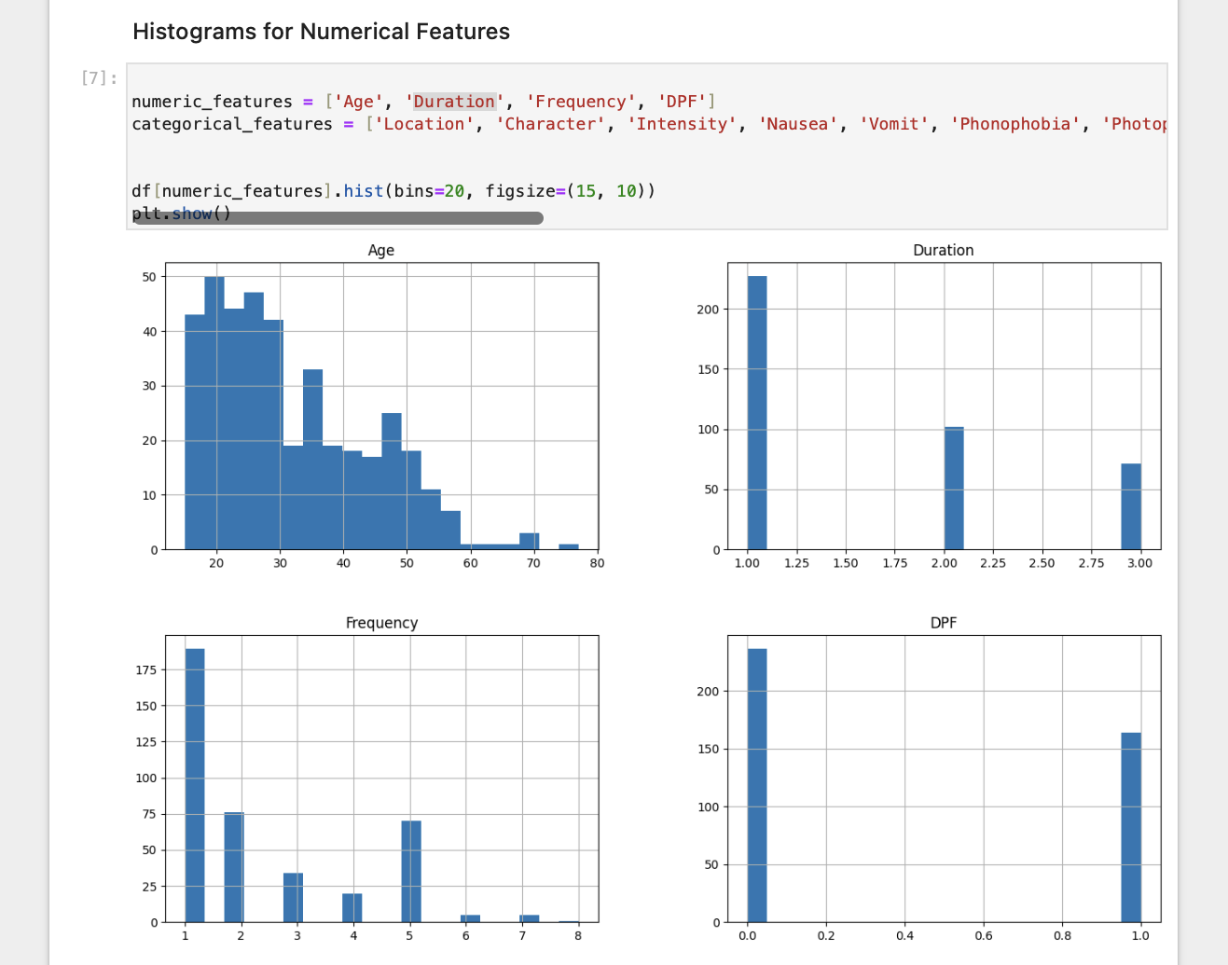
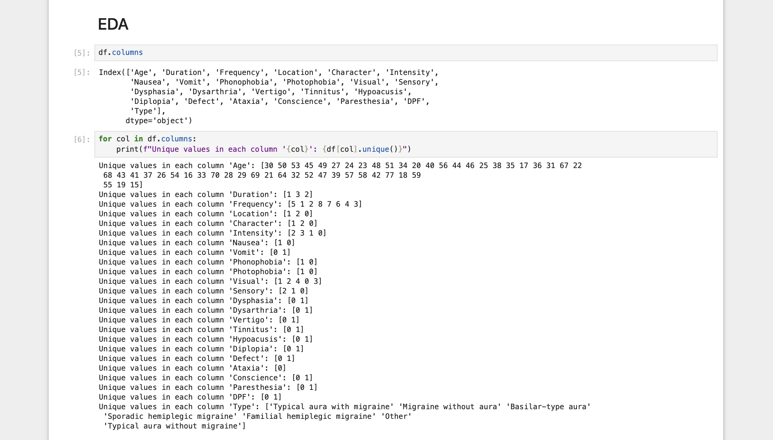
EDA

Slide 6
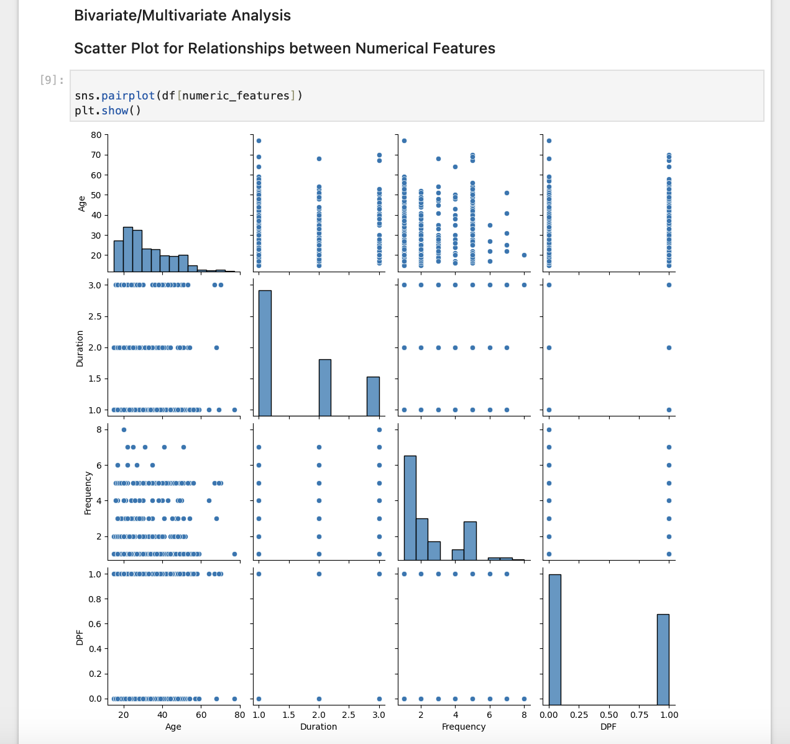

Slide 7
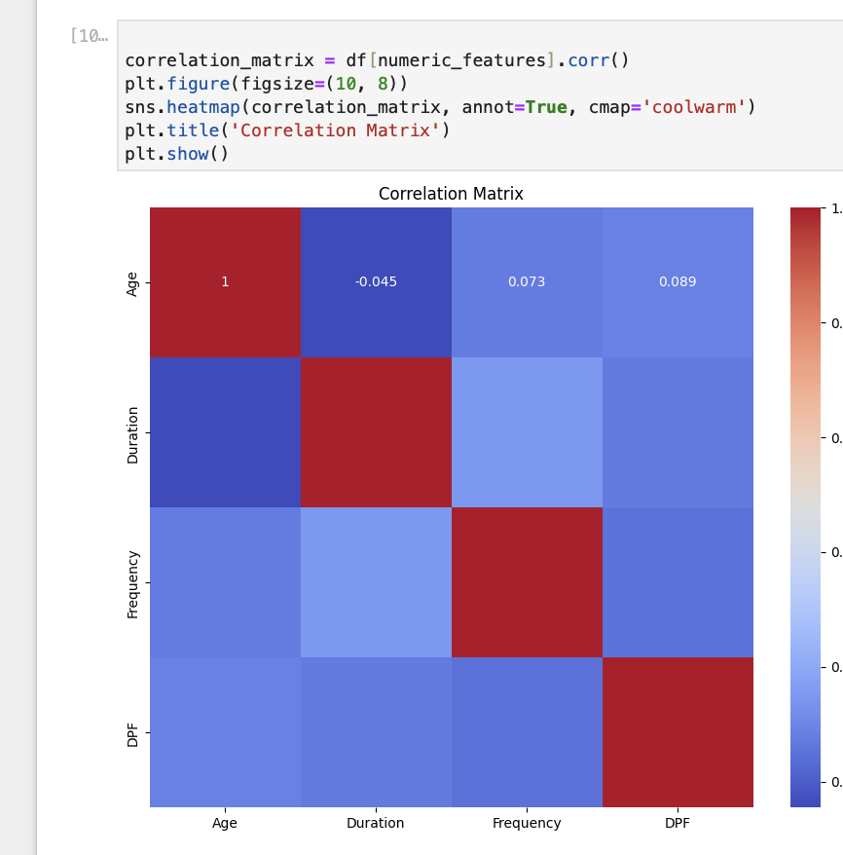
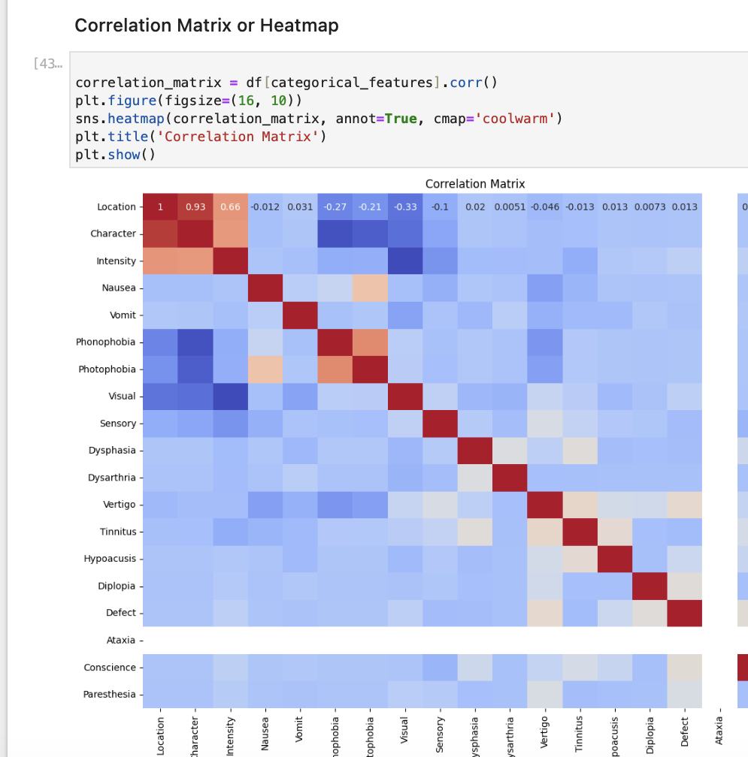

Slide 8
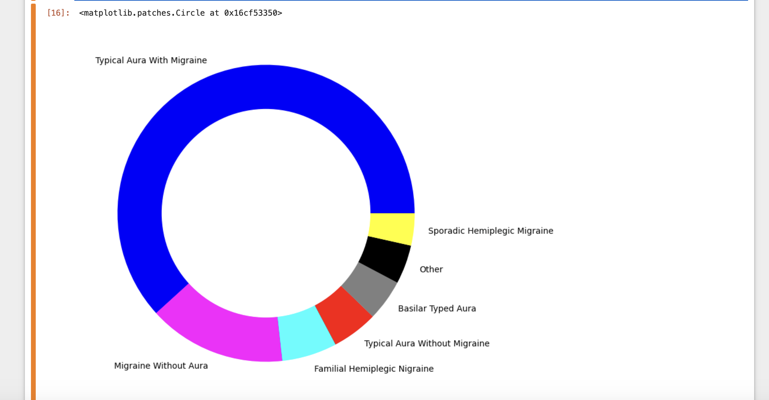
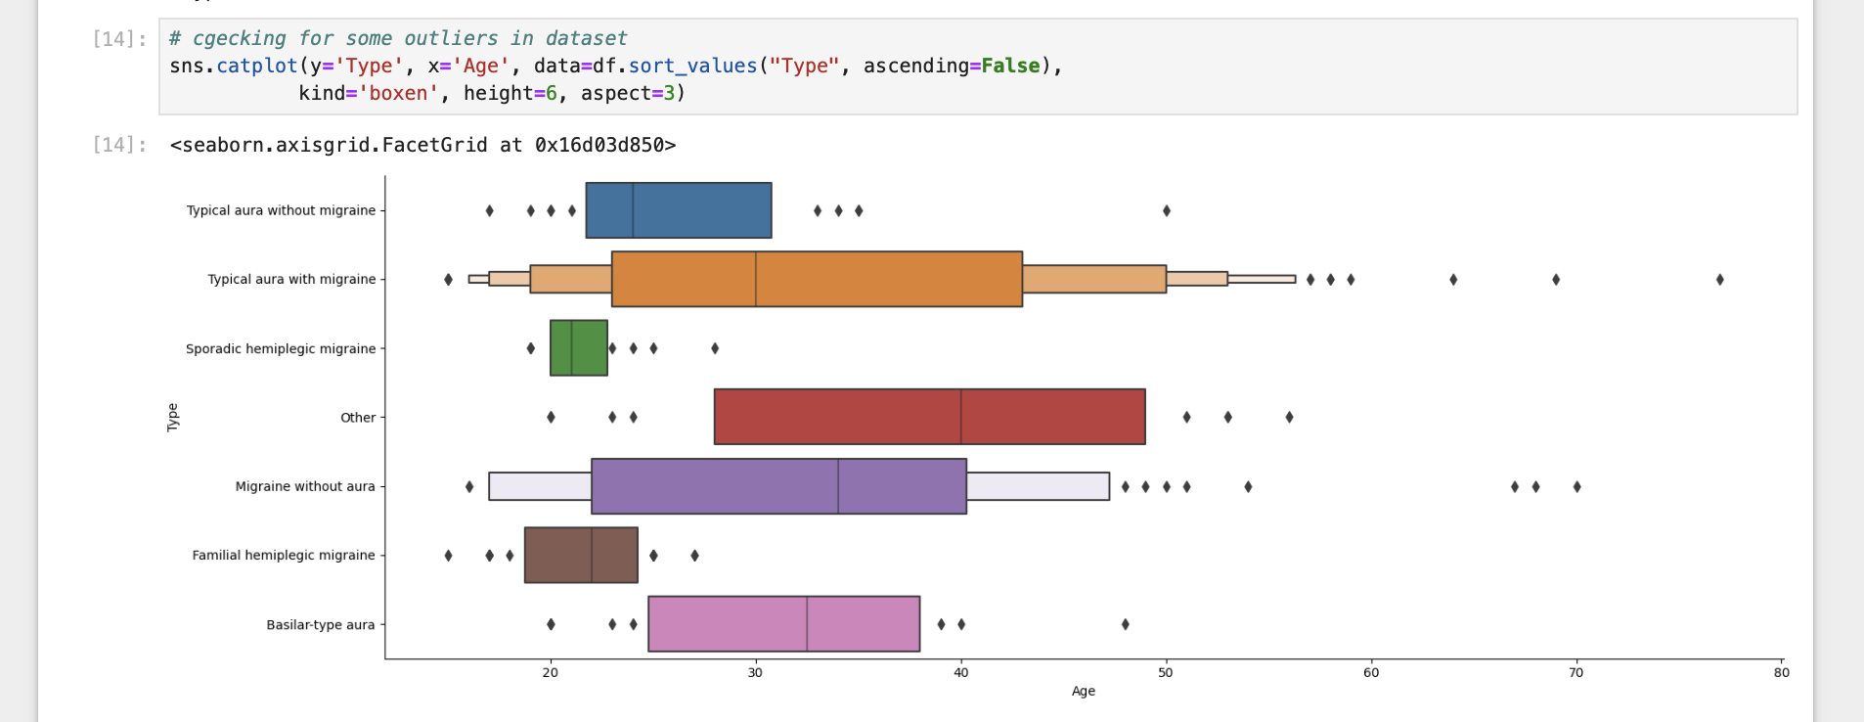

Slide 9
Algorithms
Metrics | Logistic Regression | Decision Tree | K-Nearest Neighbors | Random Forest | Naïve Bayes
Accuracy | 95 | 85 | 75 | 92 | 96
Precision | 95 | 83 | 66 | 91 | 97
Recall | 95 | 85 | 75 | 92 | 96
F1 Score | 94 | 82 | 69 | 87 | 96

Slide 10
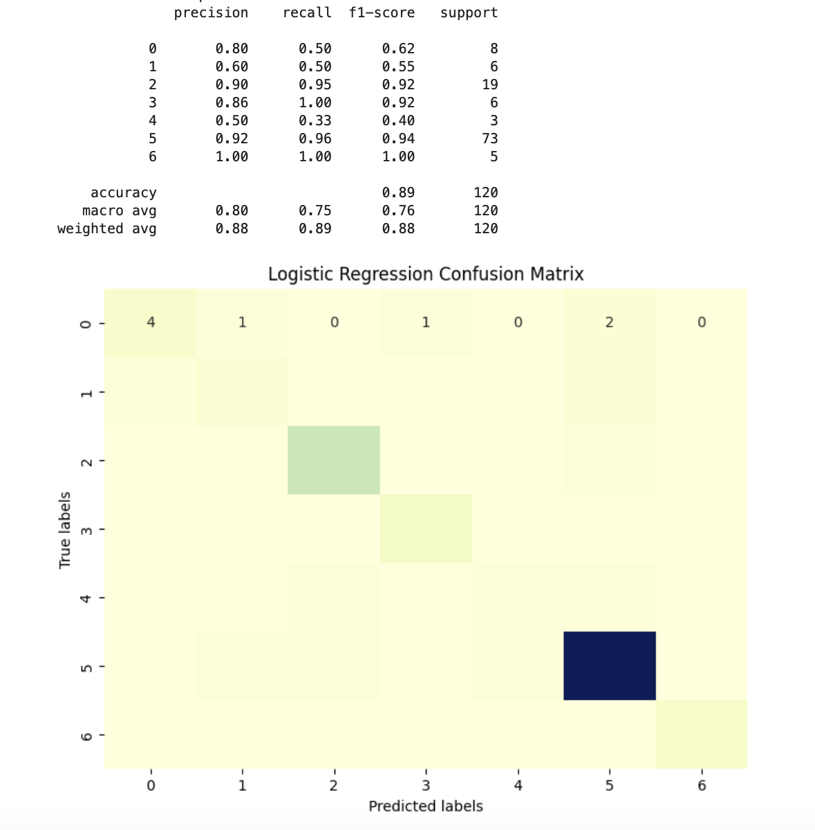
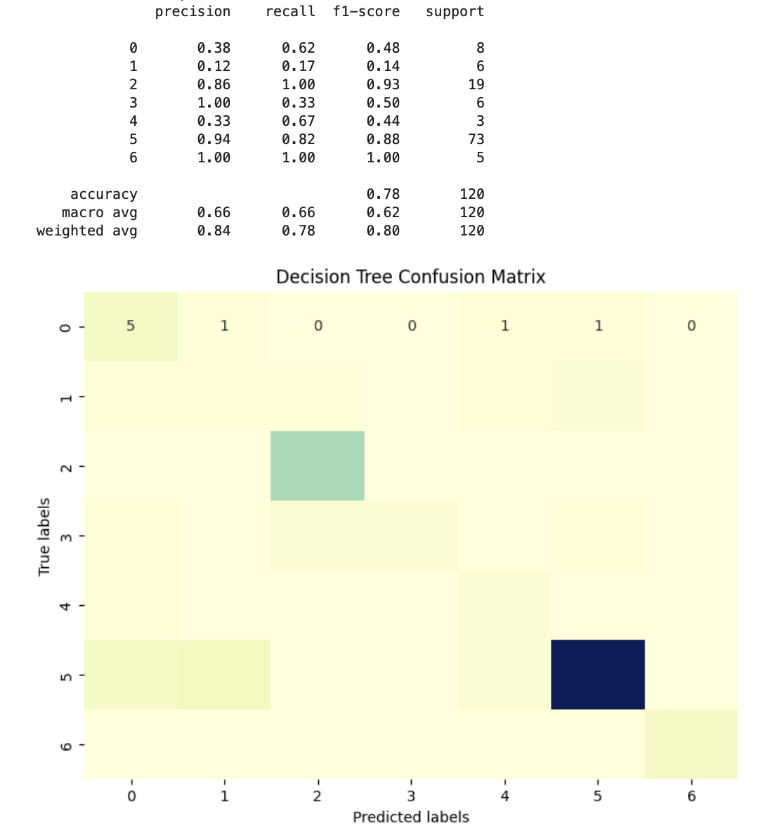

Slide 11
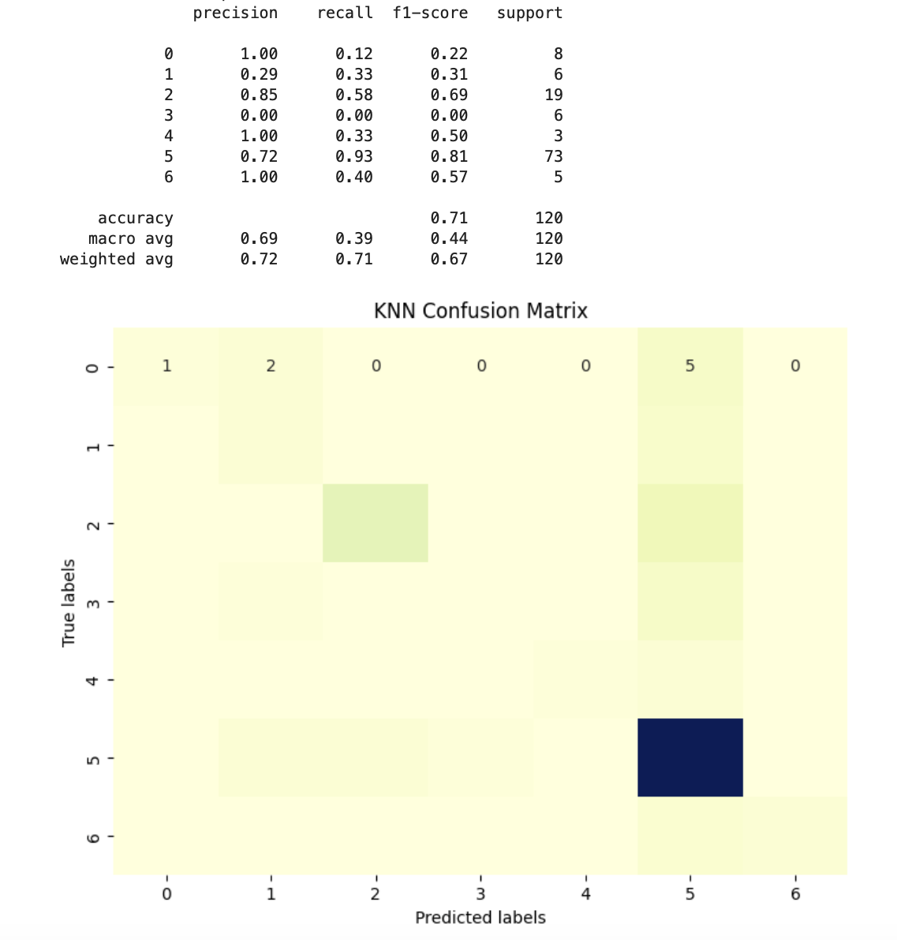
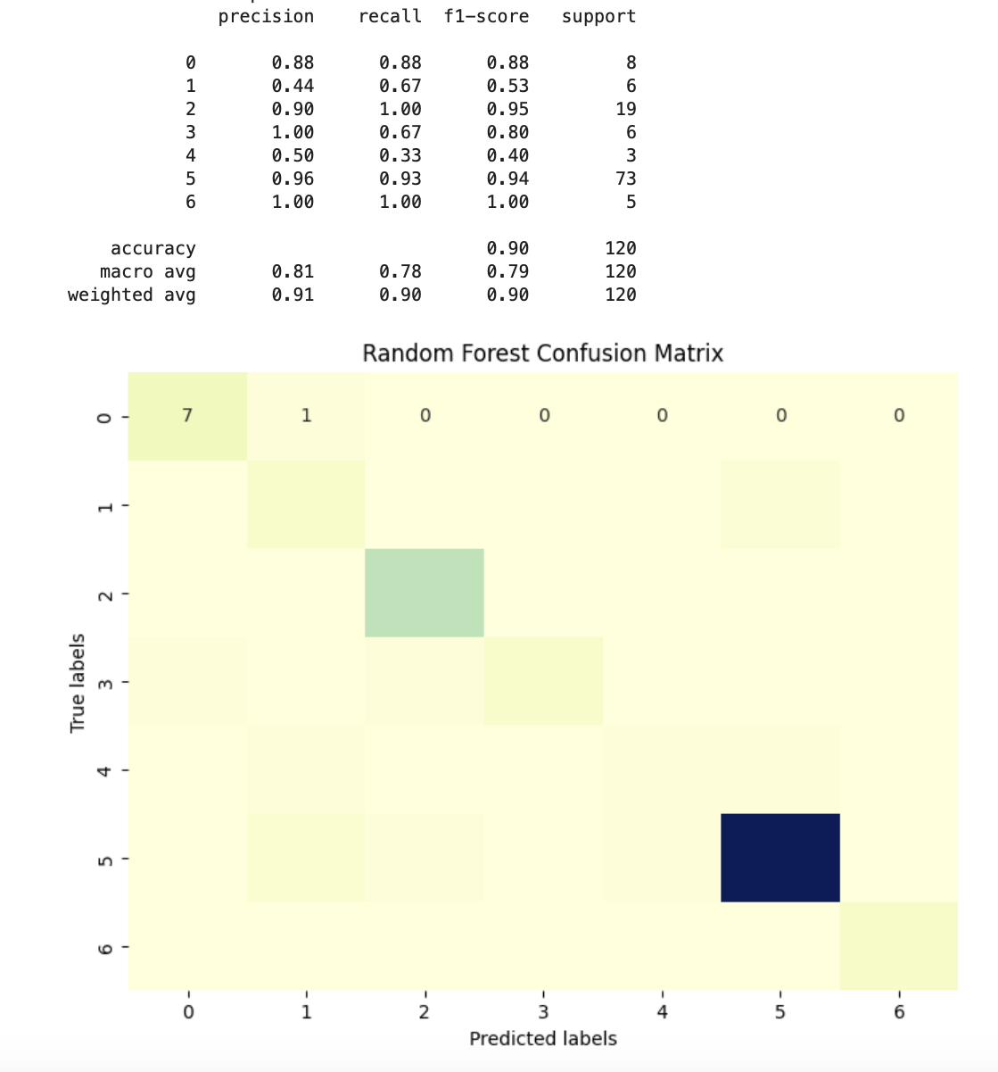

Slide 12
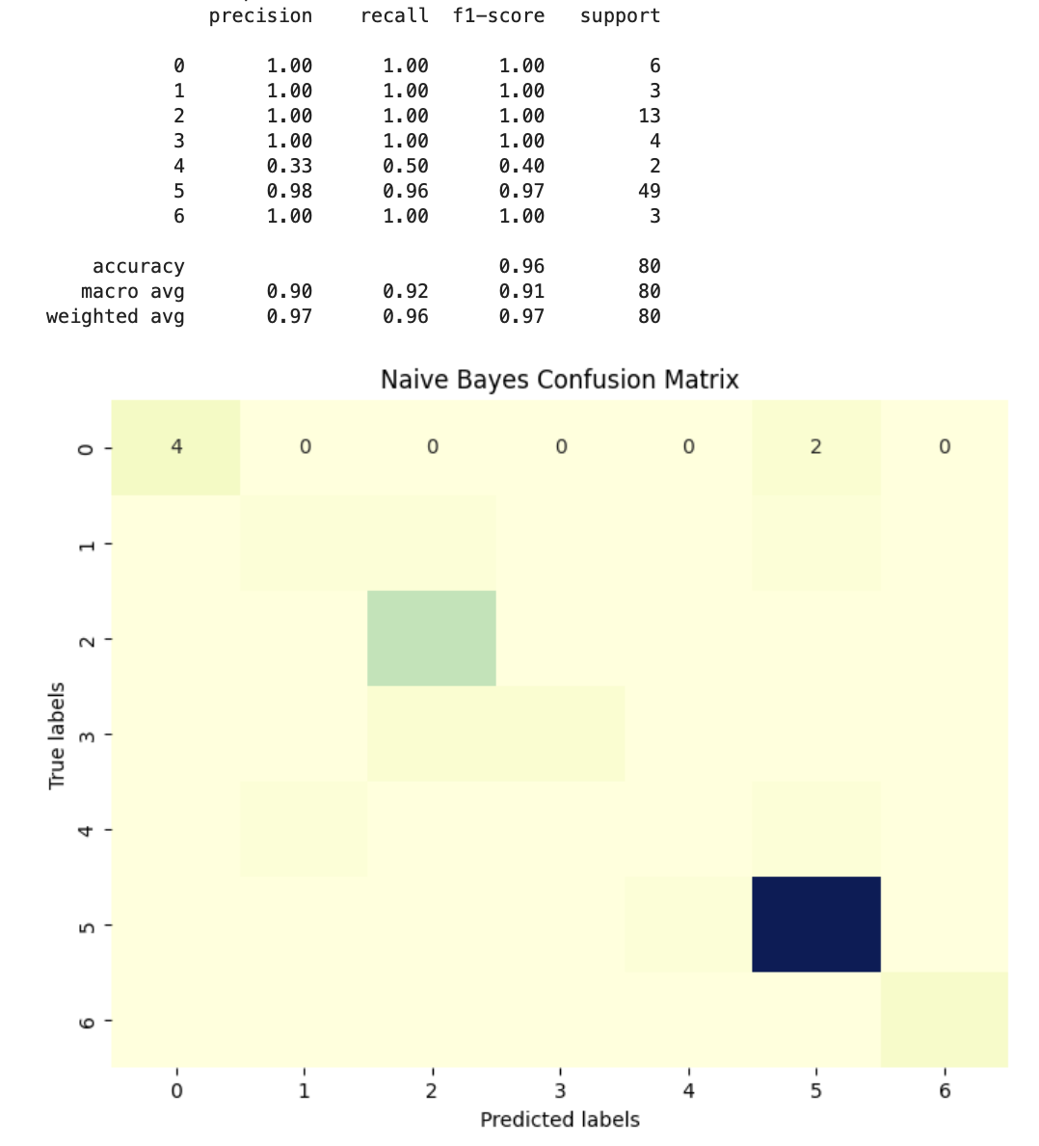

Slide 13
Challenges / Solution
Challenges
Missing data handling
Feature Identification
Handling categorial variables
Solution
Imputation
Feature scaling/Selection/ Outliers
Hyperparameter Tuning

Slide 14

Conclusion
Best-Performing Algorithm:
Naïve Bayes demonstrated the highest predictive accuracy (96.25%).
Better generalization and handling of non-linear relationships.
Limitations:
Data Size: Small dataset limits generalizability.
Imbalanced Classes: Underrepresented types may bias predictions.
Inherent Biases: Dataset reflects biases from collection methods.

Slide 15
Future Work
Experimenting with Different Algorithms or Ensemble Methods:
Objective:
Enhance predictive performance via varied machine learning algorithms.
Approach:
Experiment with algorithms beyond Random Forest (e.g., Gradient Boosting, Support Vector Machines, Neural Networks) to assess performance.
Explore ensemble methods like stacking or boosting for improved predictions.
Enhancing Feature Engineering:
Objective:
Improve model capability through informative feature creation.
Approach:
Engage domain experts for new feature identification.
Utilize techniques (e.g., forward/backward selection, PCA, LASSO regression) for influential feature identification.
Addressing Class Imbalances:
Objective:
Mitigate bias from imbalanced classes for unbiased predictions.
Approach:
Employ techniques like SMOTE, under sampling, or class weights in algorithms.

